Slide 1

MatchMetric Analytics – Unveiling Performance Insights and Trends in Tennis
- Sai Prasanth Kanamarlapudi

Slide 2
Introduction
ATP Tennis related dataset including all the information of tennis matches from January 2023 through September 11, 2023 (source: Github)
Contains player specific parameters and match specific parameters
Offers a comprehensive view of tennis, spanning player performance, match outcomes, and tournament specifics
Provides ample scope for multifaceted analysis
Uncovers intricate patterns and insights, benefiting players, coaches, and tennis enthusiasts alike
Impacts players, coaches, and tennis aficionados with insights into a beloved sport.

Slide 3
Research Questions
Predictive Modeling: Can player and match parameters accurately forecast a player's chance of winning?
Ranking Influence: What percentage of a match's favorability can be attributed to player rankings?
Handedness Impact: Investigating whether right-handed or left-handed players have a greater advantage in winning matches.

Slide 4
Methods Summary
Data Preprocessing: Employed data cleansing techniques including handling null values, standardizing column names, and formatting data types to enable analysis.
Data Visualization: Utilized bar plots and line graphs to understand match distribution by tournament surface, player seed, draw size, and age groups.
Database Querying: Utilized SQL queries to extract insights regarding match counts across tournament levels and average match duration from a created AWS RDS database.
Model Development: Created logistic regression models in Python to predict match outcomes achieving 78.3% accuracy.
Ranking & Hand Analysis: Calculated match-winning percentages based on player rankings and compared winning percentages between right-handed and left-handed players.
Technologies: Leveraged tools like RStudio, Python, AWS, SQL, and libraries like Pandas for data preprocessing, analysis, and visualization.

Slide 5
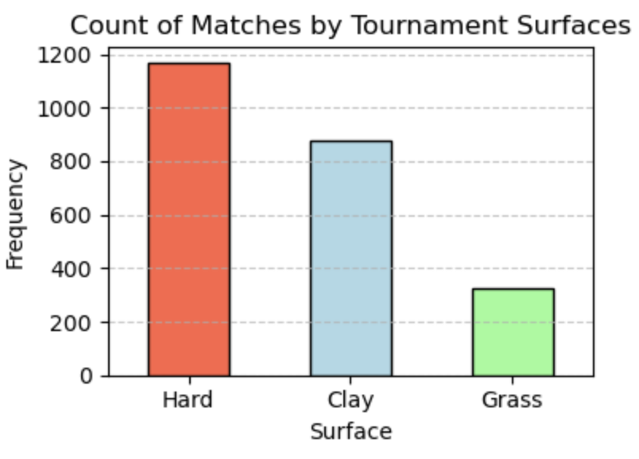
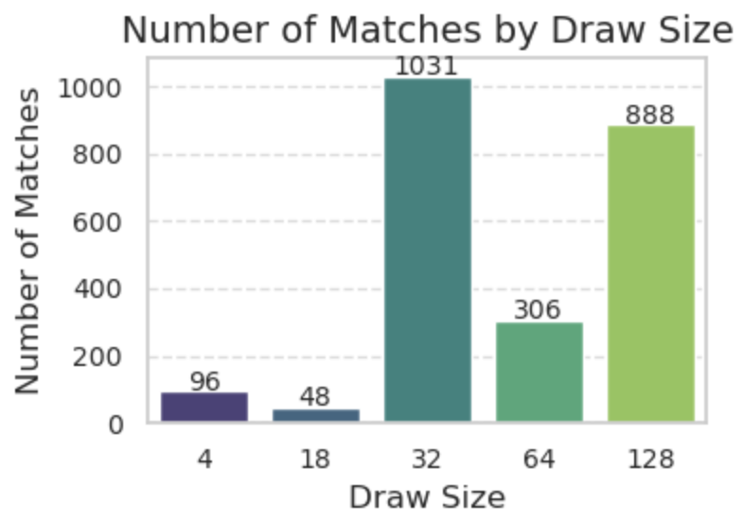
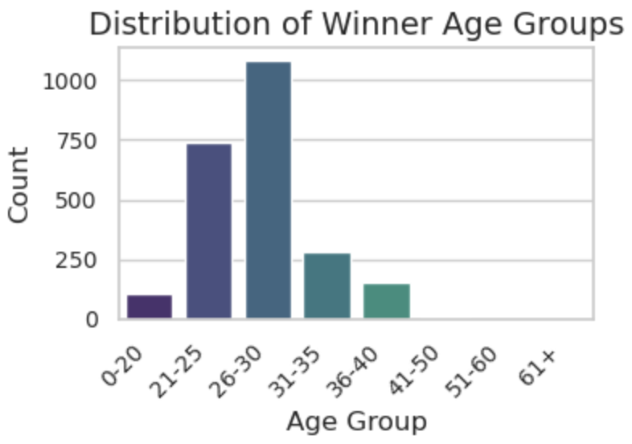
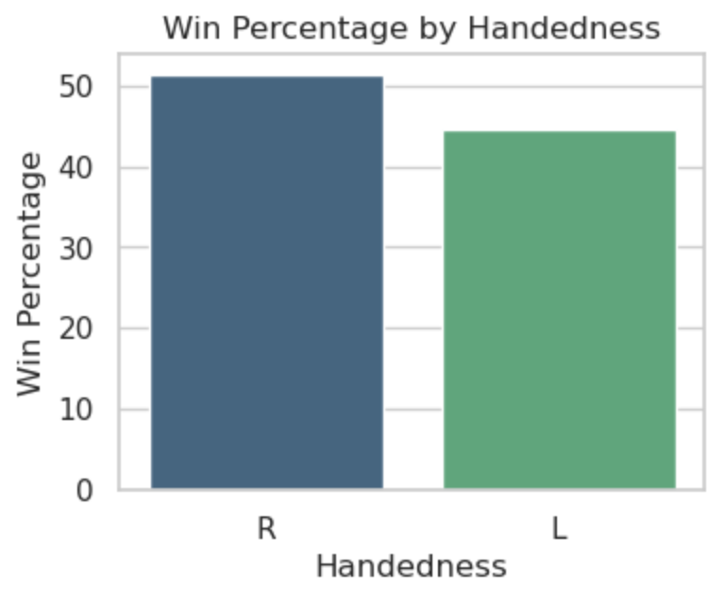
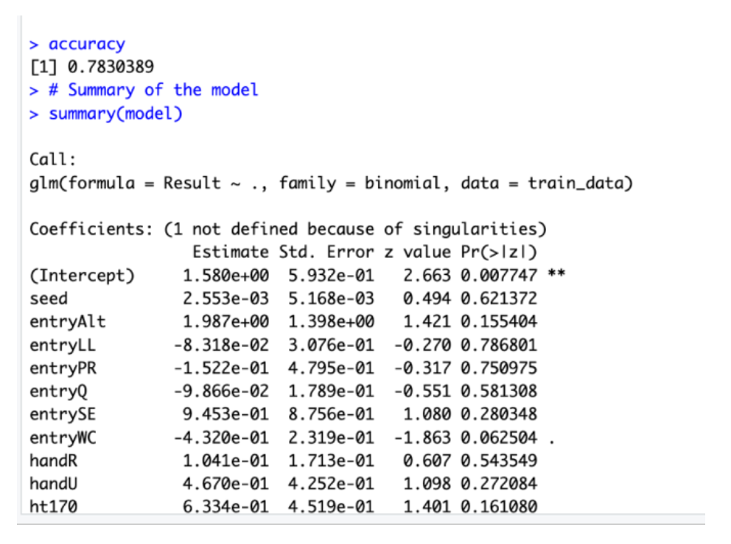
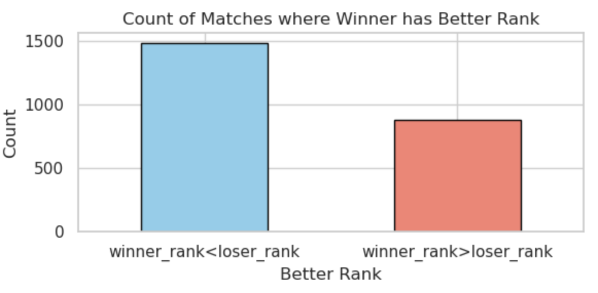
Findings Summary

Slide 6
Lessons Learned
Data Preprocessing Importance: Effective data cleaning and formatting are critical; it ensures accurate analysis and model building.
Variable Significance: Identification of significant variables enhances predictive modeling accuracy, aiding in extracting meaningful insights.
Impact of Player Characteristics: Player age, rank, and handedness affect match outcomes, underscoring their relevance in tennis analytics.
Predictive Modeling: Logistic regression serves as a reliable tool for predicting match results, providing valuable insights into player performances.
Data Visualization Insights: Graphical representations elucidate complex patterns, making it easier to comprehend and convey findings effectively.
Practical Application: Findings can potentially guide players, coaches, and analysts in devising strategies and understanding player dynamics in tennis matches.

Slide 7
Thank You

